Slide 1
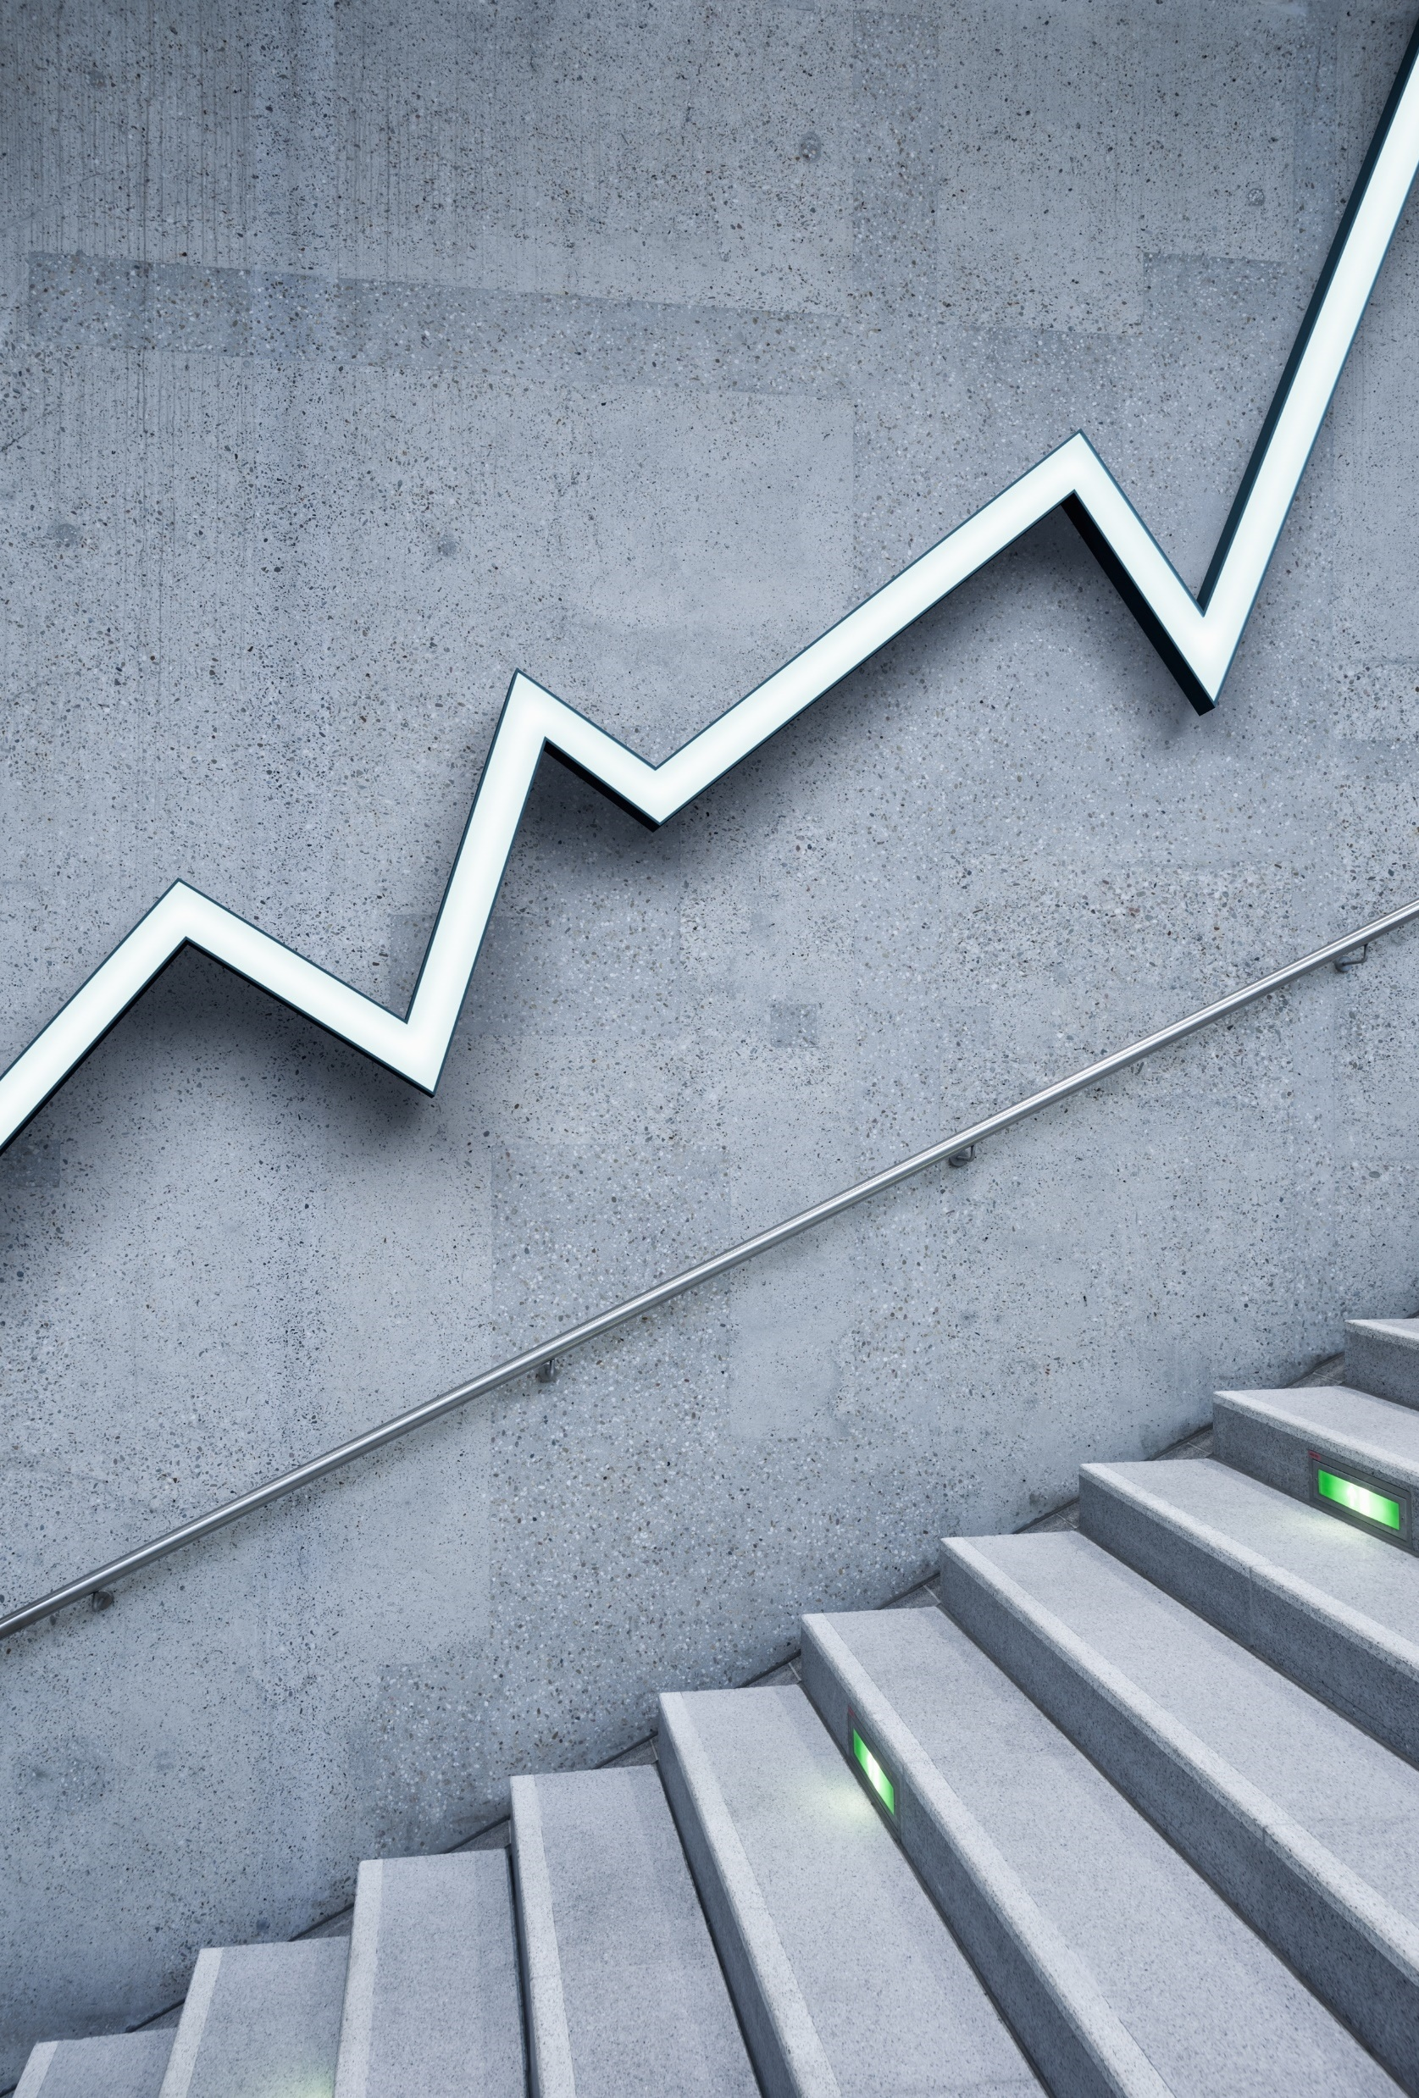
The investigation of Williamstown Data
MSU group

Slide 2
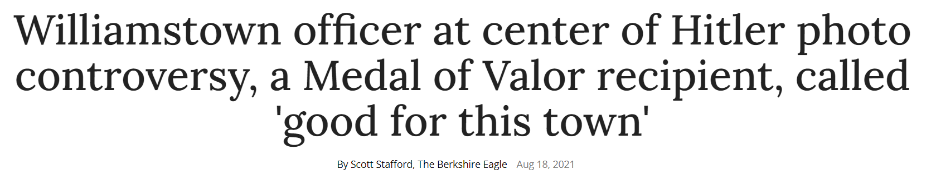
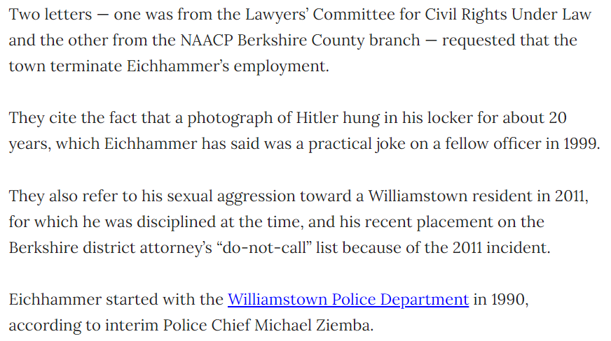

Slide 3
Research Questions
Are people of color discriminated against in Williamstown? In the state?
Can we use data to predict the biases of an officer?
Are certain demographics disproportionately pulled over at a certain time of the day?
Is the tone of voice in the police report/narrative associated with bias?

Slide 4
Demographics are proportional to the number of traffic stops by race
Race | Demographic Percentage | Percentage of all traffic stops in 2019/2020
White (broad) | 81.6 | 83.0
Black | 5.1 | 3.8
Asian | 6.3 | 1.8
Unknown | n/a | 11.4

Slide 5
Demographics are proportional to the number of total arrests per year
Race | Demographic Percentage | Percentage of all arrests in 2019 | Percentage of all arrests in 2020
White (broad) | 81.6 | 96.5 | 92.1
Black | 5.1 | 3.5 | 7.9
Asian | 6.3 | n/a | n/a
Unknown | n/a | n/a | n/a

Slide 6
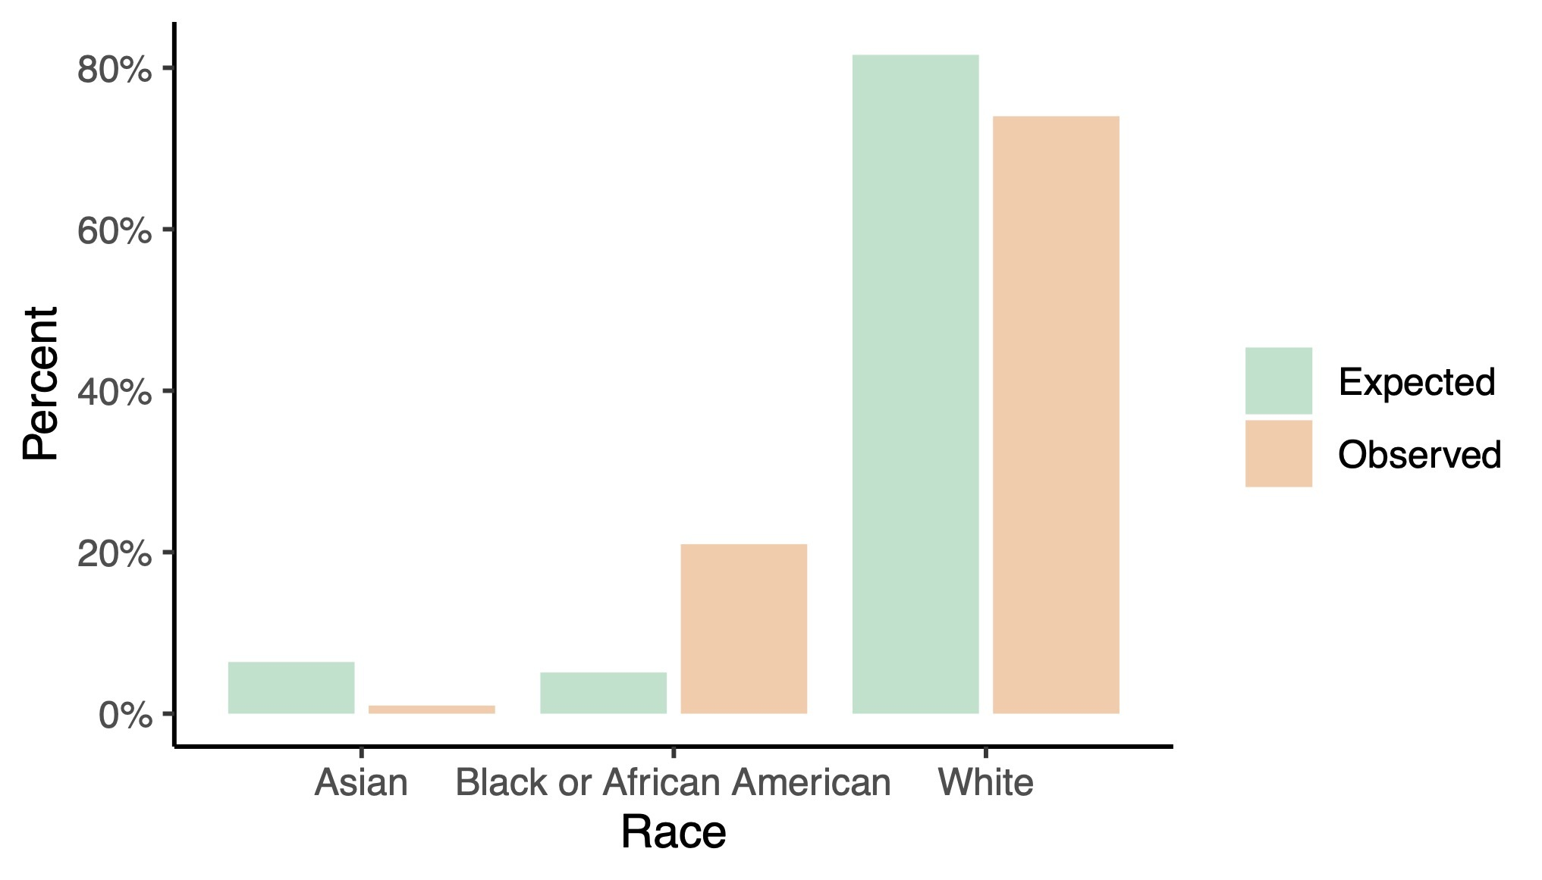
Disorderly conduct arrests in 2020 did not match expected values in Massachusetts
Disorderly conduct arrests were found on the Massachusetts website.
Data represents the entirety of Massachusetts.

Slide 7
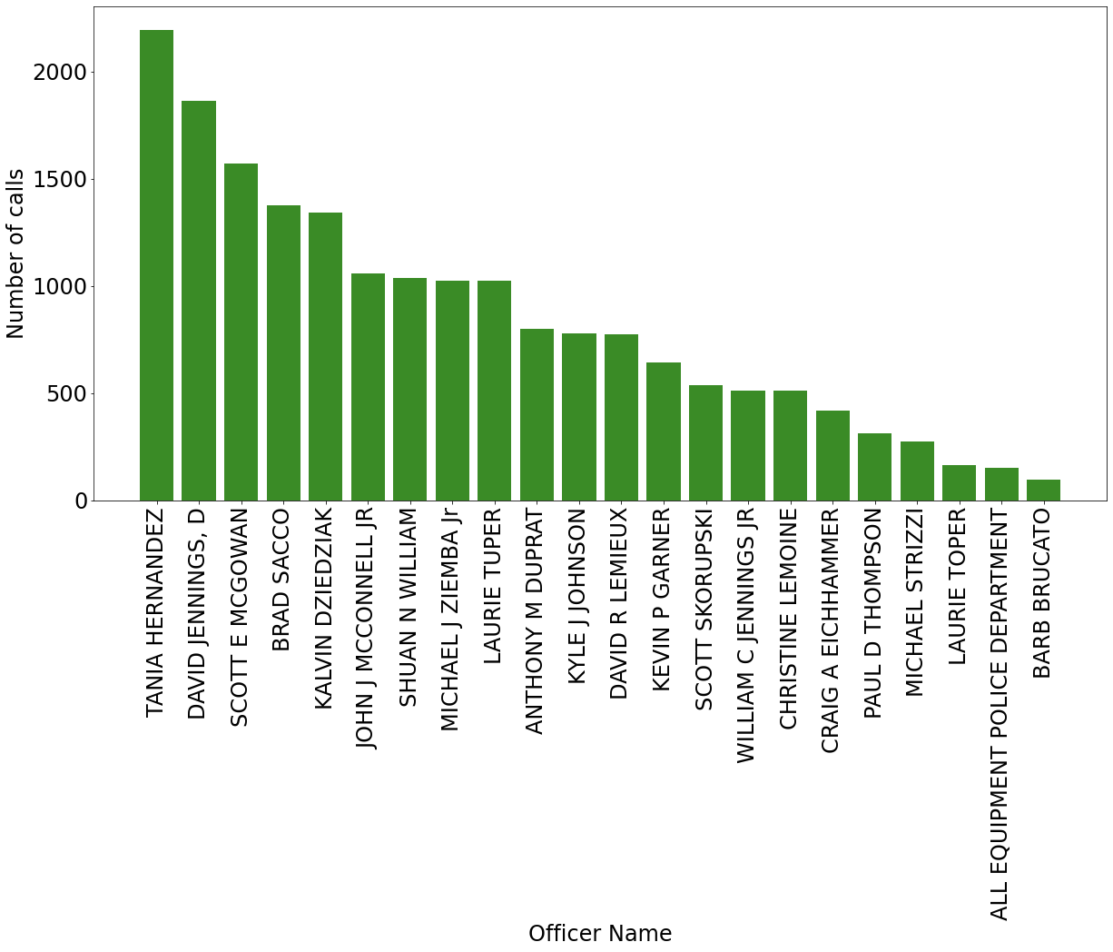
Number of calls per officer
Craig Eichhammer received fewer calls than over two-thirds of his colleagues.

Slide 8
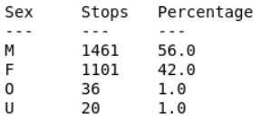
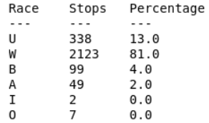
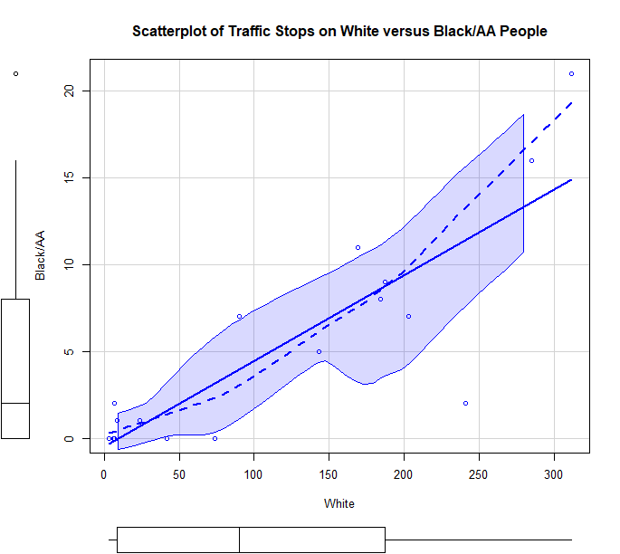
Traffic stops are slightly skewed towards the black population
By sex
By race
The number of white people pulled over could not predict the number of black people pulled over, possibly indicating bias (p = 0.054).
Only one outlier: Kevin Garner arrested 21 black people. When we removed him, the correlation became significant.
Could be a coincidence (how do we KNOW)?
Craig Eichhammer only classified people as “white” or “unknown.”
May not have reported race most times.

Slide 9
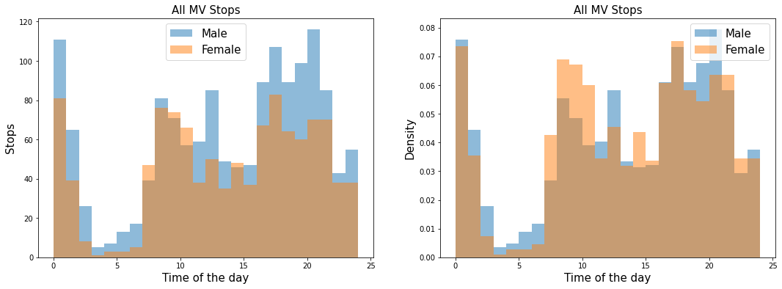
Breakdown of traffic stops by time of day and sex
Men were stopped more often than women at night and at dusk.
Women were stopped more often in the morning.

Slide 10
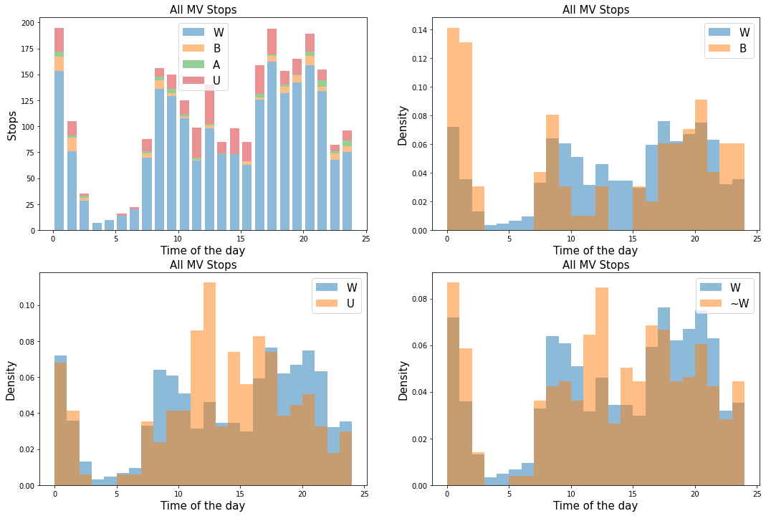
Breakdown of traffic stops by time of day and race
There are some noticeable differences in the number of traffic stops by demographic depending on the time of day.
Black people were stopped far more often at midnight (i.e., by third-shift officers).

Slide 11
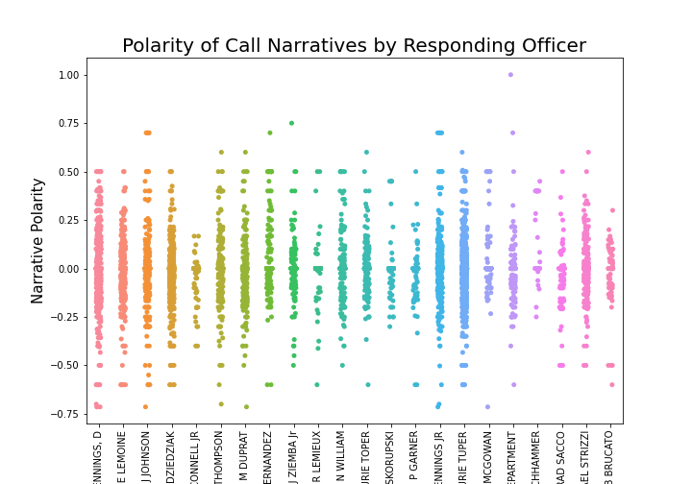
Narrative polarity by police officer
All calls were analyzed for polarity in the language.
Narratives were reported from the officers to the dispatchers who wrote them.

Slide 12
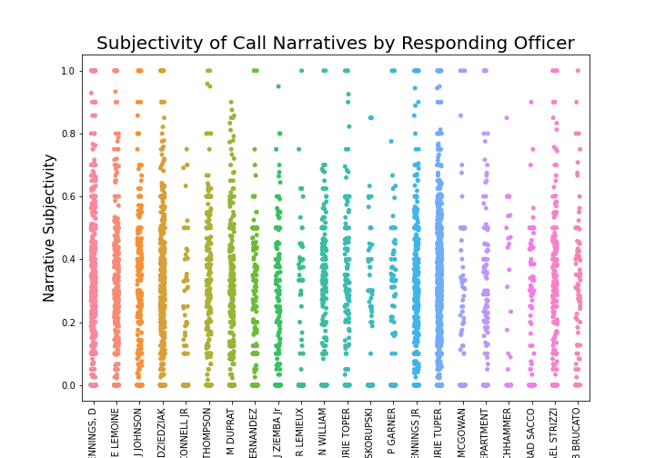
Narrative subjectivity by police officer
All calls were analyzed for subjectivity in the language.

Slide 13
Questions?
Thank you!

